Slide 1

PROJECT PLANNING & SCHEDULING (PC-2)

Slide 2
TOPICS
INTRODUCTION
SCHEDULE DEVELOPMENT
PLANNING OF EPC PROJECTS
PROGRESS REPORTING & PERFORMANCE ANALYSIS
EXERCISES AND CASE STUDY

Slide 3
1. INTRODUCTION

Slide 4
WHAT IS?
1. Project:
“Project is a temporary endeavour undertaken to create a unique product or service.” (*)
Temporary means that every project has a definite beginning and end.
(Has set start and finish)
Unique means that the product or service is different in some distinguishing way from all similar products or services.
INTRODUCTION
* PMI (PMBOK 5th Edition)

Slide 5
WHAT IS?
1. Project: (Cont.)
What is to be done (Scope)
How is it to be done (Execution Plan)
Who has responsibilities (Organization)
When will it be done (Schedule)
What is needed to do it (Resources)
INTRODUCTION

Slide 6
WHAT IS?
2. Project Management:
Project Management is the application of knowledge, skills, tools, and techniques to project activities to meet project requirements (*)
INTRODUCTION
Project management is planning, organizing, directing and controlling the resources of people, money, materials and equipment to execute a project.
* PMI (PMBOK 5th Edition)

Slide 7

7
WHAT IS?
3. The Role of Project Manager:
Project manager must balance the competing project constrains which are:
1. Scope
2. Quality
3. Schedule
4. Budget
5. Resources
6. Risk
INTRODUCTION

Slide 8
WHAT IS?
4. Deliverable:
A tangible, verifiable product, result or capability to perform a service that must be produced to complete a process, phase, or project.
INTRODUCTION

Slide 9
9
WHAT IS?
5. Project Life Cycle:
A project life cycle is the series of phases that a project passes through from its initiation to its closure (*)
The phases can be broken down by functional or partial objectives, intermediate results or deliverables, specific milestones within the overall scope of work, or financial availability
INTRODUCTION
* PMI (PMBOK 5th Edition)

Slide 10
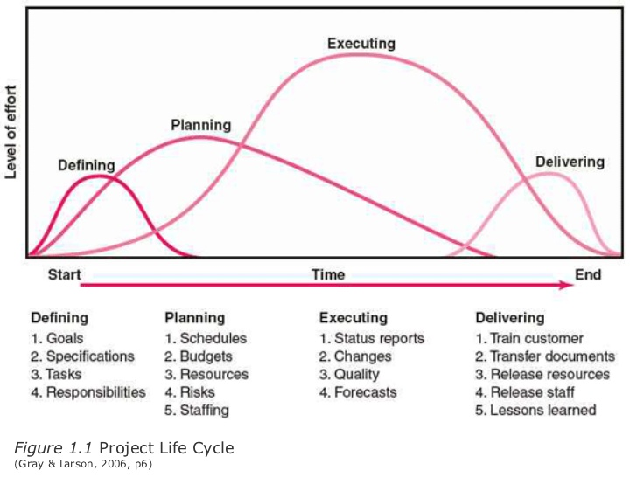
10
WHAT IS?
5. Project Life Cycle: (Cont.)
INTRODUCTION
* Gray & Larson, 2006

Slide 11
11
WHAT IS?
6. Planning:
Planning is the process of thinking about the activities required to achieve a desired goal. It involves the creation and maintenance of a plan
In other words;
Planning Is the establishment of the project activities and events, along with their resources and requirements, in their logical relationship and interrelationships to each other and the sequence in which they are to be accomplished
Planning is the arrangement of events & activities in a sequence with no consideration of time (Calendar)
INTRODUCTION
* PMI (PMBOK 5th Edition)

Slide 12
12
WHAT IS?
6. Planning: (Cont.)
The Planning process
Identifies the goals or objectives to be achieved,
Formulates strategies to achieve them
Arranges or creates the means required
Implements, directs, and monitors all steps in their proper sequence
INTRODUCTION

Slide 13
13
WHAT IS?
6. Planning: (Cont.)
Planning Questions:
What will be done? What is the breakdown?
How will this be done?
What are the major “Milestones” and decisions which must be made?
Who will do this, where& when?
Why must it be done in this way, by this (Person), (Discipline), (Craft)?
What are the obstacles in performing the work?
INTRODUCTION

Slide 14
14
WHAT IS?
7. Scheduling:
Scheduling is the application of skills, techniques, and intuition acquired through knowledge and experience to develop effective schedule models.
Schedules are the result of applying time frame and resources restraints to the plan.
Scheduling is merely producing “Project Calendar” for project activities.
The schedule model integrates and logically organizes various project components, such as activities, resources, and logical relationships, to enhance the likelihood of successful project completion within the baseline duration.
INTRODUCTION

Slide 15
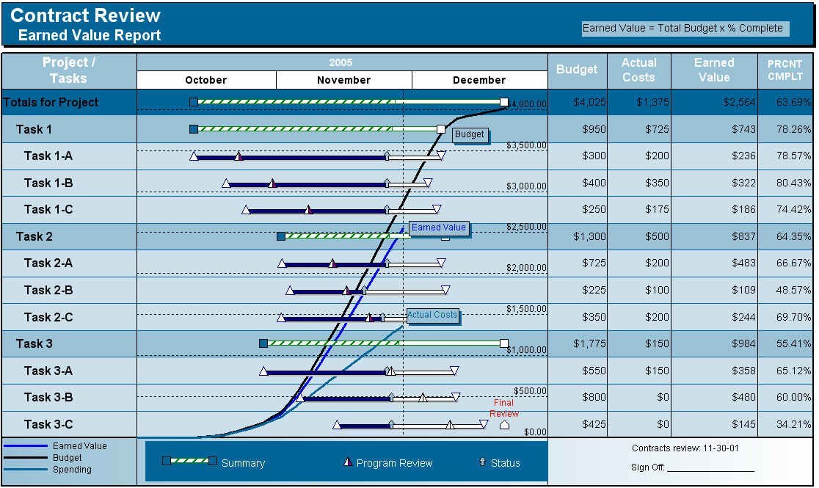

2. SCHEDULE DEVELOPMENT

Slide 16
16
WHY SCHEDULING?
The purpose of scheduling is to provide a ‘‘roadmap’’ that represents how and when the project will deliver the products defined in the project scope and by the project team.
Its main objective is to establish the time required for a project
From a contractual point of view, the schedule is an important document used to record all delays and to analyze extensions of time and financial loss claims. Another objective is to provide a tool for what if analysis
Schedule Development

Slide 17
17
WHY SCHEDULING?
The schedule supports the project by allowing for:
Time phasing of required activities
Mobilization of resources in a most efficient manner
Coordination of events within the project and between other projects
Early detection of risks or problems
Implementation of actions to achieve the project objectives as planned
Allowing for “what-if” analysis
Resource planning
Forecasting of estimate at complete
Schedule Development
* PSS (2nd edition)

Slide 18
18
Schedule Development Process Overview
The process of analyzing schedule activity sequences, schedule activity durations, resource requirements, and schedule constraints to create the project schedule.
The Schedule Development process includes:
selecting a scheduling method and scheduling tool
incorporating project specific data within that scheduling tool to develop a project specific schedule model, and generating project schedule(s)
Schedule Development

Slide 19

TYPES OF SCHEDULES
Baseline Schedule:
Once agreed upon, the first version of the schedule that is developmentally complete to be approved for capture or copied for future reference is called the project baseline schedule. This baseline becomes the benchmark against which project performance may be measured.
It is considered a contract document once approved from all parties
Schedule Development

Slide 20
TYPES OF SCHEDULES
Master Schedule:
A summary-level project schedule that identifies the major deliverables and work breakdown structure components and key schedule milestones
Schedule Development

Slide 21
TYPES OF SCHEDULES
Project Detailed Schedule:
A dynamic representation of the project’s plan for executing the project’s activities developed by the project team’s applying the scheduling method to a scheduling tool using project specific data such as activity lists and activity attributes. The schedule model can produce critical paths and instances of project schedules, as well as resource profiles, activity assignments, records of accomplishments, etc. and can provide time based forecasts, by reacting to inputs and adjustments made throughout the project’s life cycle.
Schedule Development

Slide 22
Project Detailed Schedule
Schedule Development

Slide 23
TYPES OF SCHEDULES
Look-ahead Schedule:
One month look-ahead schedules are issued periodically after the monthly cut-off date and updating the project schedule with the activities finish dates. The look-ahead schedules will be extracted from the Detailed Schedules and issued to project team for action.
Schedule Development

Slide 24
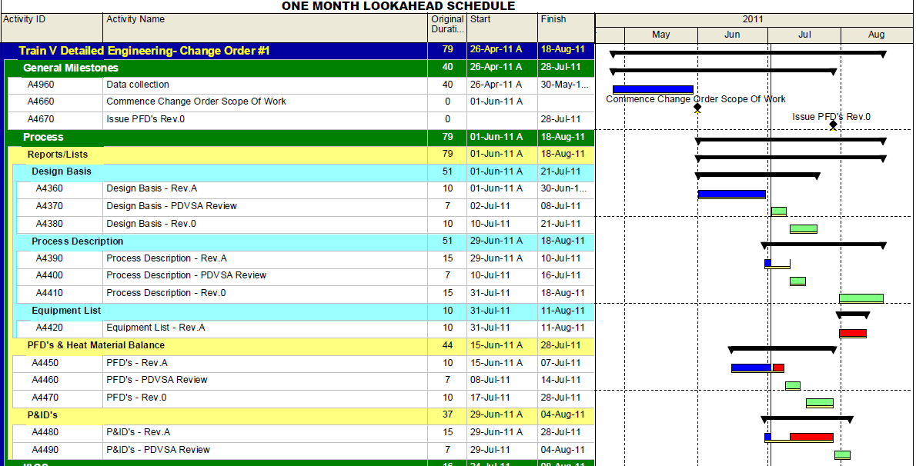
ONE MONTH LOOKAHEAD SCHEDULE
Schedule Development

Slide 25
25
Schedule Development Inputs
Project attributes
Agreements
Define Project milestones
Create Project WBS (work breakdown structure)
Establish activity list
Project calendars
Estimate activity duration
Sequence Activities
Project Network Diagrams
Project Resources
Schedule Development

Slide 26
26
1. Project Attributes
Multiple attributes associated with each unique project that can be included within the schedule model. Project attributes include, but may not be limited to project identifier, project name, project description, project scope statement, project calendar, and assigned resource calendars.
Schedule Development

Slide 27
27
2. Agreements
Agreements are used to define intentions for a project. They may take the form of contracts, memorandums of understanding (MOUs), service agreements, letters of agreement, letter of intent… etc
Typically a contract is used when a project is being performed for an external costumer
Schedule Development

Slide 28
28
3. Define Project Milestones
A significant event in the project schedule, such as an event restraining future work or marking the completion of a major deliverable. A schedule milestone has zero duration. Sometimes called a milestone activity.
Schedule Development

Slide 29
29
4. Work Breakdown Structure (WBS)
Built to divide the project scope and activities into levels and sub-levels to aid in the planning & control of activities
The process of subdividing project deliverables and project work into smaller, more manageable component.
It is the hierarchical decomposition of the total scope to be carried out by project team to accomplish project objectives and create the required deliverables.
The planned work is contained within the lowest level of WBS components , which are called work packages.
Schedule Development

Slide 30
WBS could be built by:
Project Area
Project Phase
Contract Split
Schedule Development

Slide 31
WORK BREAKDOWN STRUCTURE (WBS)
Schedule Development
1 - WBS By Project Area
Notes:
Move overview, detail is coming in later slides.

Slide 32
ABC PROJECT
Process Area
Tankage Area
Utility Area
General
Engineering
Process
PFD’S
Piping
Schedule Development
P&ID’S
Civil
Simulation /
Calculation
Procurement
Construction
Compressor
Civil Work
Tower
Piping Work
Pumps
Mechanical

Slide 33
WORK BREAKDOWN STRUCTURE (WBS)
2- WBS By Project Phase
Schedule Development
Notes:
Move overview, detail is coming in later slides.

Slide 34
XYZ Project
Engineering
Procurement
Construction
Comm. &
Start-up
Process
Equipment
Civil Work
Engineering Deliverables
PFD’S
Compressor
Buildings
Pre-comm
Comm & Start-up
Plan
P&ID’S
Heater
Foundations
Schedule Development
Data Sheets
Tower
Systems
Commissioning
Pumps
Piping
Bulk Material
Equipment
Installation
Compressor
Plot Plans
Piping
Compressor
Pumps
GA’S
Electrical
Electrical
Isometrics
Electrical

Slide 35
WORK BREAKDOWN STRUCTURE (WBS)
Schedule Development
3- WBS By Contract Split
Notes:
Move overview, detail is coming in later slides.

Slide 36
WORK BREAKDOWN STRUCTURE
LINEAR ALKYL BENZENE PROJECT (LAB)
PHASE I
PHASE II
(EPC)
Professional Services
Early
Construction
Professional
Services
Material
Supply
Construction
Schedule Development
Technology
/License
Selection
Engineering
Procurement
Management &
Controls

Slide 37
WORK BREAKDOWN STRUCTURE
LINEAR ALKYL BENZENE PROJECT (LAB)
PHASE I
Professional Services
Early Construction
Management
& controls
Technology/License
Selection
Engineering
Procurement
Services
Piles (Tanks & Non
Industrial Buildings)
Process
Bidding and
Evaluation of L.L.I
Storage Tanks
Schedule Development
Cost Estimate
Piping
Bidding and
Awarding of Services
Fence
EPC Offer
Mechanical
Soil Investigation
Non Industrial
Buildings
Civil
EIA Study
Site Levelling and
Rough Grading
Electrical
Instrument
Quality &
Environment

Slide 38
LINEAR ALKYL BENZEN
PROJECT WBS
PHASE II
PROFESSIONAL
SERVICES
Management &
Controls
Engineering
Procurement
Services
Construction
Management
Schedule Development
Process
Purchasing
General
Mechanical
Civil Work
Instrument
Fabrication
Mechanical
Work
Electrical
Electrical
Work
Piping
Civil
Instrument
Work
Equipment
Fabrication

Slide 39
39
5. Establish Activity List
Each element of the project scope, as defined in the WBS, must be supported by an activity, or activities, that will result in the completion of that part of the project scope.
Activities must be described uniquely, including a verb, at least one object, and any useful clarifying adjectives.
Activities in the schedule model represent the work that produces the deliverables or work packages identified in the WBS; thus, all work elements in the WBS should be directly traceable to a schedule activity or group of activities.
Conversely, each activity should roll up into only one WBS element.
Schedule Development

Slide 40
Important Terminology
Activity: A specific task or set of tasks that are required by the project, use up resources and take time to complete
Sequence Activities: is the process of identifying relationships among the project activities.
Network Diagram: Diagram of project activities that shows sequential relationships by use of arrows and nodes
Project Duration: The Shortest time required to complete the project
Path: The series of connected activities between two events in a network
Critical Path: The longest path; determines expected duration
Schedule Development

Slide 41
DEFINE ACTIVITIES
Rolling Wave Planning:
Form of progressively elaborating
The work to be accomplished in the near term is planned in detail and further work is planned at a higher level of the WBS.
Templates
A standard Activity Lists , Or
A portion of activity Lists from previous similar projects.
Expert Judgment
Activity List
Includes all activities required on the project.
Includes the activity identifier and a scope of work description of each activity.
Sufficient detailed to ensure that project team members understand what work is required to be completed.
Schedule Development

Slide 42
DEFINE ACTIVITIES: OUTPUTS
Activity Attributes
Extend the description of the activity.
Including Activity ID, WBS ID, activity description, predecessor and successor activities, logical relationships, leads & Lags, resource requirements, constraints and assumptions, etc,..
Can be used to:
Identify the person responsible to execute the work.
Place where the work has to be performed.
Sort activities in various ways within reports.
Milestone List
A milestone is a significant point or event in the project.
A milestone List identifies mandatory and optional milestone.
Schedule Development

Slide 43
43
6. Project Calendars
A Project calendar identifies working days and shifts that are available for scheduled activities.
These work periods may be different for specific activities or portions of the project including resources.
Some of the calendar issues to consider include:
Number of working days in a week
Number of shifts to be worked each day
Number of hours to be worked each shift or day
Any periods of scheduled ‘overtime’ work or non-working time
Holidays or non working days
Schedule Development

Slide 44
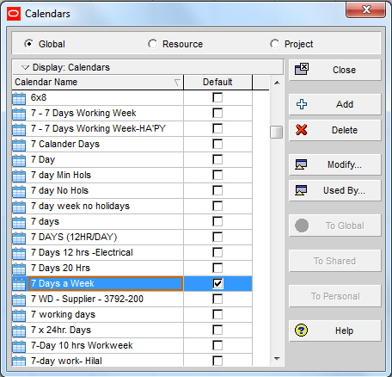
44
Schedule Development
Project Calendars Examples
Schedule Development
7 working days = 7 calendar days

Slide 45
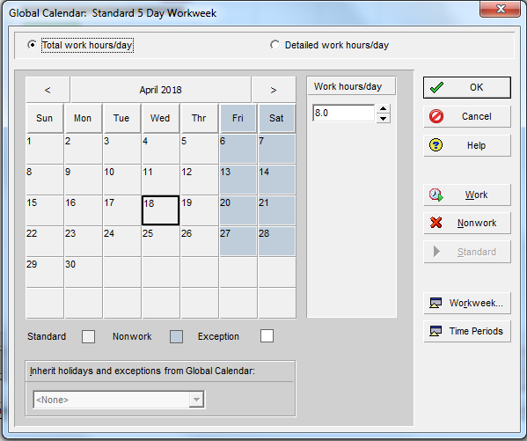
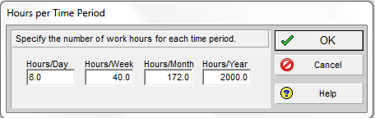
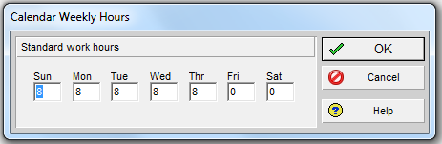
Project Calendars Examples
5 working days = 7 calendar days
Schedule Development

Slide 46
7. Estimate Activity Duration (Cont’d)
The duration is an estimate of how long it will take to accomplish the work involved in the activity.
In many cases, the number of resources that are expected to be available to accomplish an activity, together with the productivity of those resources, may determine the activity’s duration.
Schedule Development

Slide 47
7. Estimate Activity Duration (Cont’d)
Expert Judgment
Guided by historical information
Can recommend maximum activity durations and methods of estimation.
Analogous Estimating
Uses actual duration of previous similar projects as the basis for estimating the duration of the current project.
Used when there is a limited amount of detailed information about the project.
Uses historical information and expert judgment.
Less costly and time consuming.
Less accurate.
Schedule Development
47

Slide 48
7. Estimate Activity Duration (Cont’d)
Parametric Estimating
Uses a statistical relationship between historical data.
Can be determined by multiplying the quantity of work by labor hours per unit.
Three-Point Estimates
Considers the amount of risk in the original estimate
Uses 3 estimates for durations:
Optimistic – Pessimistic – Most likely.
Time Estimate (PERT): TE=(O + 4M + P)/6
Schedule Development
48

Slide 49
49
8. Sequence Activities
It is to take the activities and start to sequence them into how the work will be performed. The result is a network diagram.
Can be performed by using project management software, manual techniques or a combination of them.
Schedule Development

Slide 50
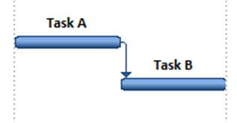
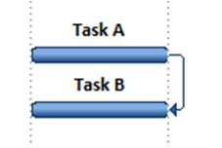
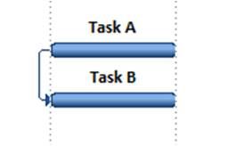
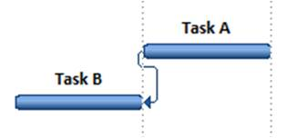
8. Sequence Activities
Precedence Diagramming Method (PDM)
A method used for constructing a project schedule Activity-On-Node (AON) diagram.
It includes four types of dependencies:
Finish-to-Start: An activity must finish before the successor can start (most common)
Finish-to-Finish: An activity must finish before the successor can finish
Start-to-Start: An activity must start before the successor can start.
Start-to-Finish: An activity must start before the successor can finish (least common)
Schedule Development

Slide 51
Activity Dependencies Examples
8. Sequence Activities
Finish-to-Start
Digging the Trench activity must finish before Pipe Laying activity can start.
Schedule Development
Finish-to-Finish
When Mobilization activity ends, all Equipment will be received at Site
Start-to-Start
When Mark Footprint activity Starts, Excavation can start.
Notes:
51

Slide 52
8. Sequence Activities
APPLYING LEADS AND LAGS
Lag: Directs a delay in the successor activity.
You must wait 3 days after pouring concrete before you can start the de-shuttering.
Lead: Allows an acceleration of the successor activity.
Code might be able to start 5 days before the design is finished.
Schedule Development

Slide 53
8. Sequence Activities
Dependency Determination
Mandatory
Is inherent in the nature of the work.
Ex: Build foundation before superstructure.
Discretionary
Schedule Development
Based on knowledge of best practices.
Ex: Build unit test cases before coding.
External
Outside the project team control.
Ex: Testing activity can be depend on the delivery of the hardware from an external source.
53

Slide 54
9- Project Network Diagrams
Schematic displays of the project’s activities and the logical relationships among them
The diagram should be accompanied by a summary narrative that describes the basic sequencing approach
Schedule Development

Slide 55
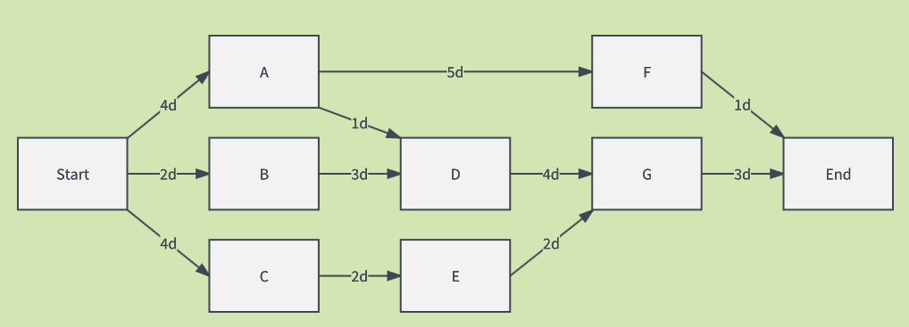
Types of Networks:
Schedule Development
Activity On Arrow (AOA): Network diagram convention in which arrows designate activities
Activity On Node (AON): Network diagram conventions in which nodes designate activities

Slide 56
Types of Networks: (Cont.)
Example: Activity (a) must be completed before (b) or (c) can start
1
2
3
4
b
a
Activity On Arrow (AOA)
c
Schedule Development
a
b
c
Activity On Node (AON)

Slide 57
Example: How many paths are in the following simple Project?
What is the Critical Path of the following simple Project?
What is the Duration of the following simple Project?
Schedule Development
B
(3)
(5)
A
E
(4)
(2)
C
(7)
D

Slide 58
Example: How many paths are in the following simple Project?
What is the Critical Path of the following simple Project?
What is the Duration of the following simple Project?
Schedule Development
B
(3)
(5)
A
E
Path 1
Duration = 8
(4)
(2)
C
(7)
D

Slide 59
Example: How many paths are in the following simple Project?
What is the Critical Path of the following simple Project?
What is the Duration of the following simple Project?
Schedule Development
B
(3)
(5)
A
E
Path 2
Duration = 13
(4)
(2)
C
(7)
D

Slide 60
Example: How many paths are in the following simple Project?
What is the Critical Path of the following simple Project?
What is the Duration of the following simple Project?
Schedule Development
B
(3)
(5)
A
E
Critical Path is Path 2
Duration = 13
(4)
(2)
C
(7)
D

Slide 61
EARLY AND LATE DATES
Early start or (ES), the earliest time activity can start, assuming all preceding activities start as early as possible
Early Finish (EF), the earliest time the activity can finish
Late start (LS), the latest time the activity can start without delaying the next activity or project completion date
Late Finish (LF), the latest time the activity can finish and not delay the next activity or project completion date
t = Activity duration
Schedule Development

Slide 62
FLOATS
Float (or Slack): The amount of time the start of a task can be delayed without impacting the schedule
Total Float: It is amount of time an activity could be delayed without affecting the project completion date.
It is calculated by:
TF = LS -ES
TF = LF -EF
Free Float: It is the amount of time an activity could be delayed without affecting the earliest start of the succeeding activity.
It is calculated by:
ES(Successor) – EF (Predecessor) = FF
Schedule Development

Slide 63
The Critical Path
The Critical Path is the series of activities that determines the duration of the project.
The Critical Path is usually defined as those activities with float equal to zero.
The Critical Path is the longest path through the project.
Schedule Development
63

Slide 64
Constraints
Imposed dates on activity starts or finishes (“start no earlier than” and “finish no later than” are the most commonly used)
Key events or main milestones: completion of certain deliverables by a specified date may be requested by project customer or other stakeholders
Imposed Sequence ( e. g. Approval Cycle)
Schedule Development

Slide 65

10. PROJECT RESOURCES
What are Project Resources?
Manpower, money, equipment and other major resources which are allocated / consumed to / by the project are identified, quantified and “allocated” to different project activities.
Schedule Development

Slide 66
ESTIMATE PROJECT RESOURCES
Estimate Activity Resources is the process of determining the type and quantities of material, personnel, equipment, or infrastructure required to perform each activity.
The key benefits of this process is that it identifies the type, quantity and characteristics of resources required to complete the activity which allows more accurate cost and duration estimate.
Both resource type and resource quantity are required
Activity duration are influenced by the number of resources assigned to them
Schedule Development

Slide 67
PROJECT RESOURCES
On a computerized CPM network, this is achieved as follows:
Resources are defined, coded and labeled as “consumable” money or “Renewable” manpower, equipment
The max value of each resource type is specified and loaded to the computer
Activity requirements of each resource type is identified and loaded to the computer
“Resource leveling” is performed
Schedule Development

Slide 68
Resource Pool Description
Knowledge of what resources will be available at what time and in what pattern.
Schedule Development

Slide 69
RESOURCE LEVELING
It is the process of “Assigning” resources needed for each network activity, on the dates at which the activity is scheduled; taking into consideration resources’ limitation.
“Resource unbound” time analysis of the network will give the resource requirements, assuming “unlimited” resource availability.
Schedule Development

Slide 70
RESOURCE LEVELING
“Resource bound” time analysis will often result in longer activity durations, due to resource availability limits.
When two activities “compete” over a limited resource, the CPM S/W will allocate the resource to the activity with less float (more critical), and “reschedules” or delays the other activity.
Schedule Development

Slide 71
RESOURCE LEVELING
They are applied to develop schedules which reflect resource constraints
Allocation of the scarce resource to critical path activities first
Fast tracking
Schedule Development

Slide 72
DETERMINE RESOURCES
Resource Requirements
Both resource type and resource quantity required
Activity duration are influenced by the number of resources assigned to them
Schedule Development

Slide 73
SCHEDULE DEVELOPMENT TOOLS
Mathematical Analysis
Calculating theoretical early and late start and finish dates for all project activities
Results indicate periods within each activity could be scheduled given problem constraints
Schedule Development

Slide 74
SCHEDULE DEVELOPMENT TOOLS
Mathematical Analysis ( cont’d)
The most widely known are:
Critical Path Method (CPM)
Graphical Evaluation and Review Technique (GERT)
Program Evaluation and Review Technique (PERT)
Schedule Development

Slide 75
SCHEDULE DEVELOPMENT TOOLS
Mathematical Analysis ( cont’d)
They look for ways to shorten the project schedule without changing the project scope
Crashing: cost and schedule tradeoffs are analysed to obtain the greatest amount of compression for the least incremental cost
Fast Tracking: doing activities in parallel that would normally be done in sequence
Schedule Development

Slide 76
Schedule Development
REFRESHING EXERCISES

Slide 77
Critical delivery dates are referred to as
A. Milestones.
B. Phases.
C. Substantial completion.
D. Flags.
Schedule Development

Slide 78
Your customer wants the project to be completed six months earlier than planned. You believe you can meet this target by overlapping project activities. The approach you plan to use is known as—
Critical chain
Fast tracking
Leveling
Crashing
Schedule Development

Slide 79
When activities are logically linked they become?
A. Constraints
B. The schedule
C. Baseline
D. Plan
Schedule Development

Slide 80
The baseline plan is a fixed document and should be changed only if the following occurs:
A. Contract modifications result due to significant changes in the work.
B. Change is allowed whenever one of the primary stakeholders thinks it appropriate.
C. Never
D. Once a year
Schedule Development

Slide 81
Which is not a phase?
A. Engineering
B. Concrete
C. Conceptual engineering
D. Pre-construction
Schedule Development

Slide 82
Which of the following is NOT a constraining resource?
A. Labor availability
B. Scheduling software
C. Material delivery
D. Craft skill levels
Schedule Development

Slide 83
You can use various estimating approaches to determine activity durations. When you have a limited amount of information available about your project, especially when in the early phases, the best approach to use is—
Expert Judgment
Analogous estimating
Reserve analysis
Parametric analysis
Schedule Development

Slide 84
You are managing a construction project for a new city water system. The contract requires you to use special titanium piping equipment that is guaranteed not to corrode. The titanium pipe must be resting in the ground a total of 10 days before connectors can be installed. In this example, the 10-day period is defined as—
Lag
Lead
Float
Slack
Schedule Development

Slide 85
You are remodeling your kitchen and decide to prepare a network diagram for this project. Your appliances must be purchased and available for installation by the time the cabinets are completed. In this example, these relationships are—
a. Start-to-finish
b. Finish-to-start
c. Start-to-start
d. Finish-to-finish
Schedule Development

Slide 86

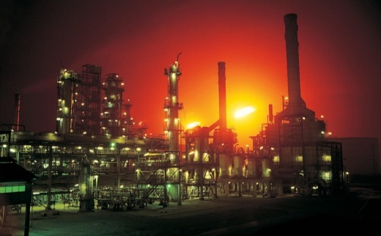
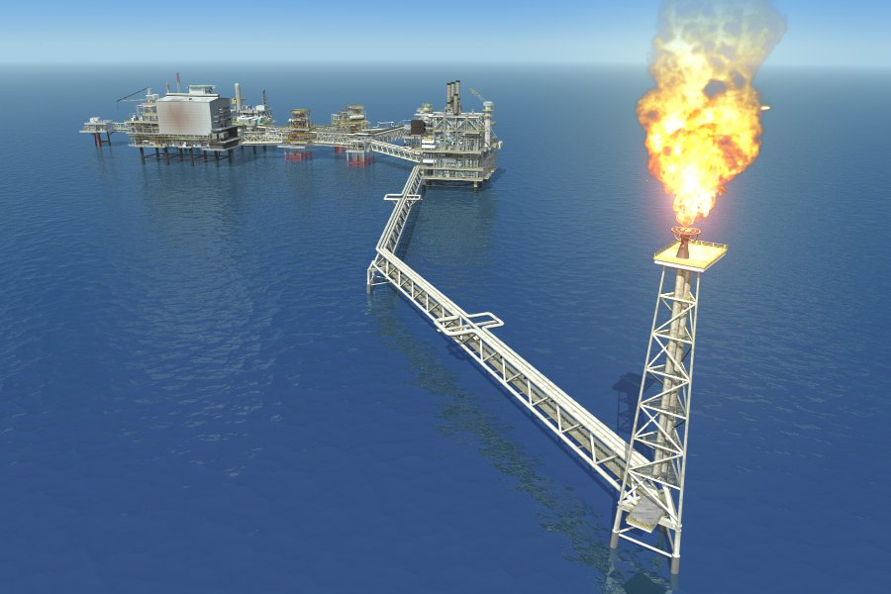
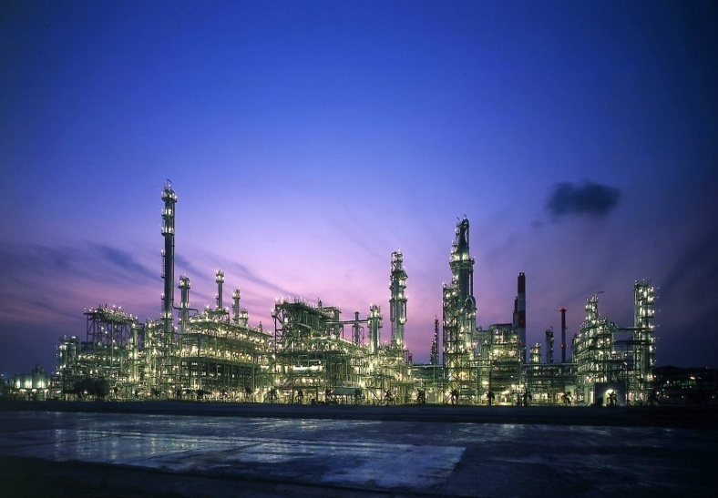
3. PLANNING OF EPC PROJECTS

Slide 87

PLANNING OF ENGINEERING ACTIVITIES
Engineering is driven by construction.
Site need dates for “Foundation Drawings” lead to the planning of civil engineering activities.
PLANNING OF EPC PROJECTS
Site need date to start pipeline laying activities dictates the plan for P/L material requisition /purchase order issuance.

Slide 88
PLANNING OF ENGINEERING ACTIVITIES
For engineering planning, activities are issuance of specifications, drawings, MRQ’s, …etc.
Resources are engineering manpower or “Man-hours”.
PLANNING OF EPC PROJECTS

Slide 89
PLANNING OF ENGINEERING ACTIVITIES
Major Inputs & Considerations
Project preliminary study or FEED
Early work planning
Codes, specifications and standards to be utilized
Requisitioning priorities
Drawing priorities
Utilization of consultants.
PLANNING OF EPC PROJECTS

Slide 90
PLANNING OF ENGINEERING ACTIVITIES
Major Inputs & Considerations (Cont.)
Vendor print requirements
Manpower requirements
Approval requirements
Organization and staffing
Utilization of prefabricated modules
Standard logical relationships/dependencies between activities.
PLANNING OF EPC PROJECTS

Slide 91
Basic Engineering Schedule
PLANNING OF EPC PROJECTS

Slide 92
DETAILED ENGINEERING
PLANNING OF EPC PROJECTS

Slide 93
PLANNING OF PROCUREMENT ACTIVITIES
Driven by site need dates for equipment / materials
Early planning guarantees meeting project schedule requirements:
During proposal/bidding/study phase
Establish suppliers list/suppliers’ qualification procedures.
Establish procurement procedures (Format, approval cycle, financing, payment procedures, ..etc.)
PLANNING OF EPC PROJECTS

Slide 94
PLANNING OF PROCUREMENT ACTIVITIES
PROCUREMENT CYCLE
Suppliers / sub-suppliers pre-qualification
Material Requisition (MRQ) preparation
Request for Quotation (RFQ) Issuance
Bid Clarifications & receipt of offers
Technical evaluation for offers
Commercial Evaluation of offers
Selection of Supplier
Order /sub-order negotiations & finalization
Purchase Order Placement
PLANNING OF EPC PROJECTS

Slide 95
PLANNING OF PROCUREMENT ACTIVITIES
During early engineering phase:
Solicit suppliers’ interest and budget quotations
Start contracting for specialized procurement services; such as overseas & inland transportation, custom clearance, inspection .etc.
PLANNING OF EPC PROJECTS

Slide 96
PLANNING OF PROCUREMENT ACTIVITIES
Logistics and Traffic Activities
Some projects require extensive planning, considering shipping limitations, port facilities limitations, customs, inland transport, …etc. as well as consideration of weather restraints.
PLANNING OF EPC PROJECTS

Slide 97
PLANNING OF CONSTRUCTION ACTIVITIES
Construction Contracting
Construction contractors / sub-contractors prequalification
Invitation to bid (ITB) preparation
Bid issuance & Clarifications
Technical evaluation for offers
Commercial bid Evaluation & Selection
Contract /sub-contract negotiations & finalization
PLANNING OF EPC PROJECTS

Slide 98
PLANNING OF CONSTRUCTION ACTIVITIES
Inputs to Planning of Construction Activities
Project type, size and location
Scope of work
Milestone/ contract schedule
Client/ contract requirements/ procedures
Contractor (s) / subcontractors qualification/ workload
Constructability analysis
PLANNING OF EPC PROJECTS

Slide 99
PLANNING OF CONSTRUCTION ACTIVITIES
Inputs to Planning of Construction Activities
Facility turnover sequence
Temporary facilities, offices, warehousing, etc.
Tools and equipment requirements.
Labor availability and productivity
Camp requirements
Climatic effects on fieldwork
Field engineering assistance requirement
Extent of subcontracting
Field organization and staffing
PLANNING OF EPC PROJECTS

Slide 100
PLANNING OF CONSTRUCTION ACTIVITIES
Constructability Analysis
Constructability analysis provides major input to construction planning through the detailed study of:
Construction sequence & equipment requirements
Oversize equipment transportation, storage and impact on construction sequence.
Weather windows (especially in Offshore projects)
Need for temporary facilities.
PLANNING OF EPC PROJECTS

Slide 101
PLANNING OF CONSTRUCTION ACTIVITIES
Work Packaging and Contract Breakdown
Construction scope of work is further divided into packages, contracts and subcontracts based on:
Contractors capabilities/availability
Project scope (Specialized such as Offshore P/L laying Vs. typical)
Schedule /financing requirements.
WBS is applied to exercise control on individual packages
PLANNING OF EPC PROJECTS

Slide 102
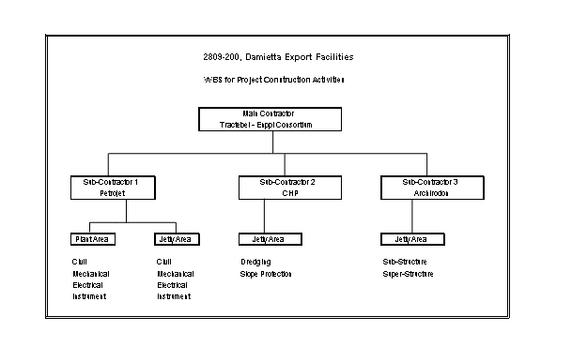

Slide 103
PLANNING OF CONSTRUCTION ACTIVITIES
Preparation of Construction Schedules
To prepare construction schedules, information availed from contract, scope of work and constructability analysis are considered:
Construction activities are listed, required resources estimated and activity durations are calculated
CPM charts and/or bar charts are developed, checked and printed.
Resources are loaded and analyzed / leveled
Schedules are optimized, reviewed and published
PLANNING OF EPC PROJECTS

Slide 104
PLANNING OF CONSTRUCTION ACTIVITIES
Preparation of Construction Schedules
Use of standard construction schedules modules can save time in schedule preparation
Construction schedules are developed for each work package separately and overall schedule is combined and checked.
Level of schedule details varies based on project execution phase
PLANNING OF EPC PROJECTS

Slide 105
PREPARATION OF CONSTRUCTION SCHEDULES
PLANNING OF CONSTRUCTION ACTIVITIES
Preparation of Construction Schedules
Site development and early construction activities (Mobilization, temporary facilities,…) and some work packages, such as non-industrial buildings, tanks, ..etc. are usually detailed early.
Detailed schedules for testing, pre-commissioning, commissioning & start-up are usually developed as summaries and are detailed at later stages.
PLANNING OF EPC PROJECTS

Slide 106
PLANNING OF CONSTRUCTION ACTIVITIES
Construction Resources
Construction resources such as: equipment, material, money or manpower are:
Construction resources are Identified, coded, availability estimated and loaded to the construction network
Needs of each construction activity of different resources are identified and loaded to the network
Network is analyzed, taking into consideration max resources availability
Resource needs (histograms) are optimized and printed.
PLANNING OF EPC PROJECTS

Slide 107
RESOURCE LEVELING
PLANNING OF CONSTRUCTION ACTIVITIES
Construction Resources
CPM software performs Resource leveling to solve conflicts arising from two (or more) activities competing over the same resource within the same period of time.
The activity with less Total Float will be scheduled first.
PLANNING OF EPC PROJECTS

Slide 108
PLANNING OF CONSTRUCTION ACTIVITIES
Types of Construction Schedules & Planning Deliverables
Logic diagrams & overall (Master) Schedule
Early construction work schedule
Detailed construction schedule (key area or work package, sub-contract,…)
Weekly / daily schedules by Craft
Commissioning & start-up detailed schedule
PLANNING OF EPC PROJECTS

Slide 109
4. PROGRESS REPORTING AND PERFORMANCE ANALYSIS

Slide 110
PROGRESS MEASUREMENT & REPORTING
Introduction
Progress Measurement
Progress Calculation
Project WBS and Progress Reporting
Progress Report Content
110

Slide 111
1. INTRODUCTION
Measuring and reporting Project Progress – during execution – is a main function of PM & PC.
Project Progress Report is a major tool in monitoring project execution. In case of project delays, progress reports present – in detail – areas of delay and possible areas of recovery.
In most of the projects, progress is used to compensate contractors, and Evaluate the performance of various disciplines participating in project execution.
Progress measurement is a major point that must be clearly specified from the early bidding stages of the project.
PROGRESS MEASUREMENT & REPORTING
111

Slide 112
(1) INTRODUCTION (Cont’d)
1. INTRODUCTION (Cont’d)
PM/PC team shall issue a periodic progress report that is:
Comprehensive; covers all project scope
Current / up-to-date
Conforming with project / contract approved procedures
Providing analysis of status / delays and proposing possible courses of actions.
PROGRESS MEASUREMENT & REPORTING
112

Slide 113
(2) PROGRESS MEASUREMENT
2. PROGRESS MEASUREMENT
Measuring achieved progress has several techniques, which are used in various cases, depending on the nature of the project / activity and the execution circumstances.
Different methods have pros & cons, for both the owner and contractor.
PROGRESS MEASUREMENT & REPORTING
113

Slide 114
114
2. PROGRESS MEASUREMENT (Cont’d)
Different methods for progress measurement – for separate activities:
(1) Supervisor Opinion.
(2) Start / Finish.
(3) Units Completed.
(4) Incremental Milestones
PROGRESS MEASUREMENT & REPORTING

Slide 115
115
2. PROGRESS MEASUREMENT (Cont’d)
(1) Supervisor Opinion
Minor Tasks Only
Subjective - Use as Last Resort
% Complete = Judgment
Examples: Dewatering, temporary construction, & landscaping
PROGRESS MEASUREMENT & REPORTING

Slide 116
(2) PROGRESS MEASUREMENT (Cont’d)
116
2. PROGRESS MEASUREMENT (Cont’d)
(2) Start / Finish
Activities require short time
Effort is difficult to measure
Not easily identifiable milestones
Example:
Pump Alignment
Progress @ start = 0% or 10 to 20%
Progress @ finish = 100%
PROGRESS MEASUREMENT & REPORTING

Slide 117
117
2. PROGRESS MEASUREMENT (Cont’d)
(3) Units Completed
Partially finished units are negligible
% Complete = To-Date/Total Scope
Examples: Electrical Wire Pulling - 4,000 LM/10,000 LM = 40.0% Complete
PROGRESS MEASUREMENT & REPORTING

Slide 118
118
2. PROGRESS MEASUREMENT (Cont’d)
(4) Incremental Milestones
Subtasks are Sequential
Distinct milestones have pre-defined progress %
In-between progress in not credited
Widely utilized in Engineering, Procurement and Construction Projects
PROGRESS MEASUREMENT & REPORTING

Slide 119
(3) PROGRESS CALCULATION
3. PROGRESS CALCULATION
Progress of Different Project activities is linked together in one overall Project Progress Report through assigning Relative Weights
Several techniques are utilized to determine the relative weights of contract / project activities; such as:
(1) Equivalent Monetary %.
(2) Standard Man-hours.
PROGRESS MEASUREMENT & REPORTING
119

Slide 120
(3) PROGRESS CALCULATION (Cont’d)
3. PROGRESS CALCULATION (Cont’d)
(1) Equivalent Monetary %.
Civil, Mechanical, Electrical, …etc. scope is priced and percentages are specified.
Within Civil; excavation, concrete, steel, …etc. scope is priced and percentages are specified.
So on, until we reach separate lists of uniform tasks that can be measured in m² or m³, or Tons, …etc.; then the relatives weights are based on quantity.
PROGRESS MEASUREMENT & REPORTING
120

Slide 121
3. PROGRESS CALCULATION (Cont’d)
(2) Standard Man-hours.
Various Construction activities can be assigned Standard Man-hours.
Standard man-hours are assigned $ value.
Relative weights of various construction activities can then be easily specified.
PROGRESS MEASUREMENT & REPORTING
121

Slide 122
4. PROJECT WBS AND PROGRESS REPORTING
To build a progress report for the project, we normally develop the project Work Breakdown Structure (WBS) or follow the WBS imposed by the Client / Tender / Contract.
WBS is commonly built to match the project scope and cost split
Will be used to summarize/report various levels and types of planning reports
PROGRESS MEASUREMENT & REPORTING
122

Slide 123
(5) PROGRESS REPORT CONTENT
5. PROGRESS REPORT CONTENT
Periodic progress reports summarize the work achieved through a specific reporting period. The report contents illustrate the activities performed, ongoing and forecasted, besides, a brief description of the project, parties involved and summary status for Top Management review and others.
Elaboration of progress figures analysis, with WBS level summation and the relevant impact on the project critical activities represent the major part of the progress report.
Progress report contents may vary according to the recipients. (Normally, internal progress reports are different from external).
PROGRESS MEASUREMENT & REPORTING
123

Slide 124
MONTHLY PROGRESS REPORTS
Planning Part of the Monthly Progress Report
Monthly report is related to the work performed during the last reporting period.
All plans and reported actual shall be based on contract baseline. Progress on Approved Variations will be reported but will be segregated until rolled into a further contract baseline. Contract baseline planned figures shall always be shown. The report, which shall be submitted to Client no later than ten Calendar Days from Cut-off Date, shall include the following Items:
PROGRESS MEASUREMENT & REPORTING

Slide 125
MONTHLY PROGRESS REPORTS
Management summary including the following:
Executive summary narrative highlighting major activities accomplished during the reporting period for the total Project.
Executive summary narrative highlighting major activities planned during the upcoming reporting period for the total Project.
Overall progress tabulation; actual versus Contract Baseline planned showing Engineering, procurement, Construction/Pre-Commissioning, Commissioning and Start-Up.
Overall Project 'S' curve showing planned, actual.
Major milestone status showing scheduled / actual dates.
Updated Schedule.
Areas of concern.
One month look ahead.
Proposals to recover lost time on any tasks which are behind schedule.
PROGRESS MEASUREMENT & REPORTING

Slide 126
MONTHLY PROGRESS REPORTS
Engineering activities status including
Engineering progress 'S' curves, showing planned, and actual.
Engineering progress by discipline showing actual versus planned during the month and cumulated.
Engineering progress narrative stating Major achievements during the month by each discipline & Major Items to be achieved during the next month.
Latest drawing/document register print out.
PROGRESS MEASUREMENT & REPORTING

Slide 127
MONTHLY PROGRESS REPORTS
Procurement activities status including:
Progress narrative covering purchasing, expediting, inspection and shipping, stating achievements during the month.
Procurement status for equipment and materials that shall include the planned, expected and actual dates for the following :
Material Requisition Issued for Inquiry.
Technical Evaluation.
Commercial Evaluation.
Placement of Purchase Order.
Ex-Work Delivery.
Shipping to port of destination.
Arrival to Site.
3. Procurement progress 'S' curves, showing planned, and actual.
PROGRESS MEASUREMENT & REPORTING

Slide 128
MONTHLY PROGRESS REPORTS
Construction activities status including:
A narrative summary of main activities for the month on each major area and subcontract, and planned activities for the following month.
A tabulation showing progress status, plan versus actual, for each work area.
Progress 'S' curves for overall construction.
Construction Manpower/Equipment histograms.
PROGRESS MEASUREMENT & REPORTING

Slide 129
SAMPLE OF OVERALL S-CURVE
PROGRESS MEASUREMENT & REPORTING

Slide 130
SAMPLE OF PROGRESS SUMMARY
PROGRESS MEASUREMENT & REPORTING

Slide 131
5. EXERCISES AND CASE STUDY

Slide 132
EXERCISES AND CASE STUDY
Exercise 1
1. Draw the AOA Network Diagram
2. What is the critical path?
3. How many days can activity F slip without extending the project end date?
Activity | Duration | Dependencies
A | 3 | ---
B | 4 | A
C | 8 | A
D | 1 | C
E | 4 | A
F | 3 | E
G | 2 | C, B

Slide 133
SCHEDULE DEVELOPMENT
EXERCISES AND CASE STUDY
Exercise 1
1. Draw the AOA Network Diagram
2. What is the critical path?
3. How many days can activity F slip without extending the project end date?
(A, 3)

Slide 134
SCHEDULE DEVELOPMENT
EXERCISES AND CASE STUDY
Exercise 1
1. Draw the AOA Network Diagram
2. What is the critical path?
3. How many days can activity F slip without extending the project end date?
(A, 3)
(B, 4)
(C, 8)

Slide 135
SCHEDULE DEVELOPMENT
EXERCISES AND CASE STUDY
Exercise 1
1. Draw the AOA Network Diagram
2. What is the critical path?
3. How many days can activity F slip without extending the project end date?
(B, 4)
(A, 3)
(C, 8)
(D, 1)
(E,4)

Slide 136
EXERCISES AND CASE STUDY
Exercise 1
1. Draw the AOA Network Diagram
2. What is the critical path?
3. How many days can activity F slip without extending the project end date?
(B, 4)
(A, 3)
(D, 1)
(C, 8)
(E,4)
(F, 3)

Slide 137
SCHEDULE DEVELOPMENT
EXERCISES AND CASE STUDY
Exercise 1
1. Draw the AOA Network Diagram
2. What is the critical path?
3. How many days can activity F slip without extending the project end date?
(B, 4)
(G, 2)
(A, 3)
(C, 8)
(D, 1)
(E,4)
(F, 3)

Slide 138
EXERCISES AND CASE STUDY
Exercise 1
1. Draw the AOA Network Diagram
2. What is the critical path?
3. How many days can activity F slip without extending the project end date?
(B, 4)
(G, 2)
(A, 3)
(C, 8)
(D, 1)
(E,4)
(F, 3)

Slide 139
EXERCISES AND CASE STUDY
Exercise 1
1. Draw the AOA Network Diagram
2. What is the critical path?
3. How many days can activity F slip without extending the project end date?
(B, 4)
(G, 2)
Path 1
Duration = 9
(A, 3)
(C, 8)
(D, 1)
(E,4)
(F, 3)

Slide 140
EXERCISES AND CASE STUDY
Exercise 1
1. Draw the AOA Network Diagram
2. What is the critical path?
3. How many days can activity F slip without extending the project end date?
Path 2
Duration = 12
(B, 4)
(G, 2)
(A, 3)
(C, 8)
(D, 1)
(E,4)
(F, 3)

Slide 141
EXERCISES AND CASE STUDY
Exercise 1
1. Draw the AOA Network Diagram
2. What is the critical path?
3. How many days can activity F slip without extending the project end date?
Path 3
Duration = 13
(B, 4)
(G, 2)
(A, 3)
(C, 8)
(D, 1)
(E,4)
(F, 3)

Slide 142
EXERCISES AND CASE STUDY
Exercise 1
1. Draw the AOA Network Diagram
2. What is the critical path?
3. How many days can activity F slip without extending the project end date?
Path 4
Duration = 10
(B, 4)
(G, 2)
(A, 3)
(C, 8)
(D, 1)
(E,4)
(F, 3)

Slide 143
EXERCISES AND CASE STUDY
Exercise 1
1. Draw the AOA Network Diagram
2. What is the critical path?
3. How many days can activity F slip without extending the project end date?
Critical Path
Duration = 13
(B, 4)
(G, 2)
(A, 3)
(C, 8)
(D, 1)
(E,4)
(F, 3)

Slide 144
EXERCISES AND CASE STUDY
Exercise 1
1. Draw the AOA Network Diagram
2. What is the critical path?
3. How many days can activity F slip without extending the project end date?
Path 4
Duration = 10
(B, 4)
(G, 2)
(A, 3)
(C, 8)
(D, 1)
(E,4)
(F, 3)
Float = 3

Slide 145
EXERCISES AND CASE STUDY
Exercise 2
1. Draw the AON Network Diagram
2. What is the Critical Path?
 | 2
Activity A
 | 5
Activity B
Start
SS
 | 1
Activity E
 | 2
Activity G
 | 3
Activity C
 | 2
Activity D
 | 2
Activity F
SS

Slide 146
EXERCISES AND CASE STUDY
Exercise 2
1. Draw the AON Network Diagram
2. What is the Critical Path? (Forward Calculation – Path 1)
1 | 2 | 2
Activity A
3 | 5 | 7
Activity B
8
9
0 | 0 | 0
Start
SS
 | 1
Activity E
 | 2
Activity G
 | 3
Activity C
 | 2
Activity D
 | 2
Activity F
SS

Slide 147
EXERCISES AND CASE STUDY
Exercise 2
1. Draw the AON Network Diagram
2. What is the Critical Path? (Forward Calculation – Path 2)
1 | 2 | 2
Activity A
3 | 5 | 7
Activity B
6
7
8
9
0 | 0 | 0
Start
SS
 | 1
Activity E
 | 2
Activity G
1 | 3 | 3
Activity C
4 | 2 | 5
Activity D
 | 2
Activity F
SS

Slide 148
EXERCISES AND CASE STUDY
Exercise 2
1. Draw the AON Network Diagram
2. What is the Critical Path? (Forward Calculation – Path 3)
1 | 2 | 2
Activity A
3 | 5 | 7
Activity B
5
6
6
7
8
9
0 | 0 | 0
Start
SS
4 | 1 | 4
Activity E
 | 2
Activity G
1 | 3 | 3
Activity C
4 | 2 | 5
Activity D
 | 2
Activity F
SS

Slide 149
EXERCISES AND CASE STUDY
Exercise 2
1. Draw the AON Network Diagram
2. What is the Critical Path? (Forward Calculation – Path 4)
1 | 2 | 2
Activity A
3 | 5 | 7
Activity B
6
7
5
6
6
7
8
9
0 | 0 | 0
Start
SS
4 | 1 | 4
Activity E
 | 2
Activity G
1 | 3 | 3
Activity C
4 | 2 | 5
Activity D
4 | 2 | 5
Activity F
SS

Slide 150
EXERCISES AND CASE STUDY
Exercise 2
1. Draw the AON Network Diagram
2. What is the Critical Path? (Backward Calculation – Path 4)
1 | 2 | 2
Activity A
3 | 5 | 7
Activity B
6
7
5
6
6
7
8
9
0 | 0 | 0
Start
SS
4 | 1 | 4
Activity E
8 | 2 | 9
Activity G
8 |  | 9
3
3
1 | 3 | 3
Activity C
4 | 2 | 5
Activity D
3
5
6
7
4 | 2 | 5
Activity F
6 |  | 7
SS

Slide 151
EXERCISES AND CASE STUDY
Exercise 2
1. Draw the AON Network Diagram
2. What is the Critical Path? (Backward Calculation – Path 3)
1 | 2 | 2
Activity A
3 | 5 | 7
Activity B
6
7
5
6
6
7
8
9
0 | 0 | 0
Start
SS
4 | 1 | 4
Activity E
7 |  | 7
8 | 2 | 9
Activity G
8 |  | 9
3
3
1 | 3 | 3
Activity C
4 | 2 | 5
Activity D
3
5
6
7
4 | 2 | 5
Activity F
6 |  | 7
4
6
7
8
SS

Slide 152
EXERCISES AND CASE STUDY
Exercise 2
1. Draw the AON Network Diagram
2. What is the Critical Path? (Backward Calculation – Path 2)
1 | 2 | 2
Activity A
3 | 5 | 7
Activity B
6
7
5
6
6
7
8
9
0 | 0 | 0
Start
SS
4 | 1 | 4
Activity E
7 |  | 7
8 | 2 | 9
Activity G
8 |  | 9
3
3
1 | 3 | 3
Activity C
4 | 2 | 5
Activity D
3
5
6
7
4 | 2 | 5
Activity F
6 |  | 7
4
6
7
8
SS
3
5
6
7

Slide 153
EXERCISES AND CASE STUDY
Exercise 2
1. Draw the AON Network Diagram
2. What is the Critical Path? (Backward Calculation – Path 1)
1 | 2 | 2
Activity A
1 |  | 2
3 | 5 | 7
Activity B
3 |  | 7
6
7
5
6
6
7
8
9
0 | 0 | 0
Start
SS
4 | 1 | 4
Activity E
7 |  | 7
8 | 2 | 9
Activity G
8 |  | 9
3
3
1 | 3 | 3
Activity C
3 |  | 5
4 | 2 | 5
Activity D
6 |  | 7
3
5
6
7
4 | 2 | 5
Activity F
6 |  | 7
4
6
7
8
SS
3
5
6
7

Slide 154
EXERCISES AND CASE STUDY
Exercise 2
1. Draw the AON Network Diagram
2. What is the Critical Path? (Calculating Float = LD-ED)
1 | 2 | 2
Activity A
1 | 0 | 2
3 | 5 | 7
Activity B
3 | 0 | 7
0 | 0 | 0
Start
0 | 0 | 0
SS
4 | 1 | 4
Activity E
7 | 3 | 7
8 | 2 | 9
Activity G
8 | 0 | 9
1 | 3 | 3
Activity C
3 | 2 | 5
4 | 2 | 5
Activity D
6 | 2 | 7
4 | 2 | 5
Activity F
6 | 2 | 7
SS

Slide 155
EXERCISES AND CASE STUDY
Exercise 2
1. Draw the AON Network Diagram
2. What is the Critical Path? (Critical Path)
1 | 2 | 2
Activity A
1 | 0 | 2
3 | 5 | 7
Activity B
3 | 0 | 7
4
0 | 0 | 0
Start
0 | 0 | 0
SS
4 | 1 | 4
Activity E
7 | 3 | 7
8 | 2 | 9
Activity G
8 | 0 | 9
1 | 3 | 3
Activity C
3 | 2 | 5
4 | 2 | 5
Activity D
6 | 2 | 7
4 | 2 | 5
Activity F
6 | 2 | 7
SS

Slide 156
EXERCISES AND CASE STUDY
Crashing Cost
B
A
C
D
Crash cost / day | Crash cost $ | Normal cost $ | Crash duration | Normal duration | Activity
1000 | 8000 | 6000 | 2 | 4 | A
750 | 5750 | 5000 | 4 | 5 | B
500 | 8500 | 8000 | 6 | 7 | C
2000 | 8000 | 6000 | 4 | 5 | D
156

Slide 157
EXERCISES AND CASE STUDY
EXERCISE “1”
NO
ACTIVITY
DURATION
PRECEDING
1
MOVE IN
3
-
2
EXCAVATION
8
1
3
PREPARE FORM
7
1
4
PREPARE STEEL REB.
4
1
5
POUR PLAIN CONCRETE
1
2
6
SET FORM
2
3,5
7
SET RFT. STEEL
3
4,6
8
POUR CONCRETE
1
7

Slide 158
EXERCISES AND CASE STUDY
EXERCISE “1”
REQUIRED:
USING CPM METHOD DRAW PERT CHART.
DETERMINE THE CRITICAL PATH(S).
CALCULATE THE FLOAT FOR EACH ACTIVITY.
DRAW GANTT CHART SHOWING THE FLOAT FOR EACH ACTIVITY.

Slide 159
EXERCISES AND CASE STUDY
EXERCISE “1”
ACT. ID | DURATION DAYS | PRECEDING ACTIVITY | COST / DAY $ | RESOURCE “X” DAILY
1 | 2 | - | 50
2 | 6 | 1 | 100
3 | 4 | 1 | 100
4 | 10 | 2 | 200 | 10
5 | 10 | 2 | 200 | 10
6 | 6 | 2 | 200 | 5
7 | 4 | 3 | 200 | 10
8 | 12 | 4 & 5 | 300 | 5
9 | 4 | 6 | 300 | 5
10 | 6 | 6 & 7 | 300 | 5
11 | 8 | 8 | 200
12 | 4 | 9 & 10 | 200
13 | 6 | 10 | 200
14 | 6 | 11,12 & 13 | 100

Slide 160
EXERCISES AND CASE STUDY
EXERCISE “1”
REQUIRED:
Using CPM method draw pert chart.
Determine the critical path(s).
Calculate the float for each activity.
Draw Gantt chart showing the float for each activity.
Draw the s-curve for early and late cases.
Prepare a histogram to show the loading of resource “x”.
Make resource leveling for best usage of resource “x”

